Slide 1
Pádraig Naughton
Executive Director

Slide 2
Arts & Disability Ireland use the UN Convention on the Rights of Persons with Disabilities definition:
‘Persons with disabilities include those who have long-term physical, mental, intellectual or sensory impairments which, in interaction with various barriers, may hinder their full and effective participation in society on an equal basis with others.’

Slide 3
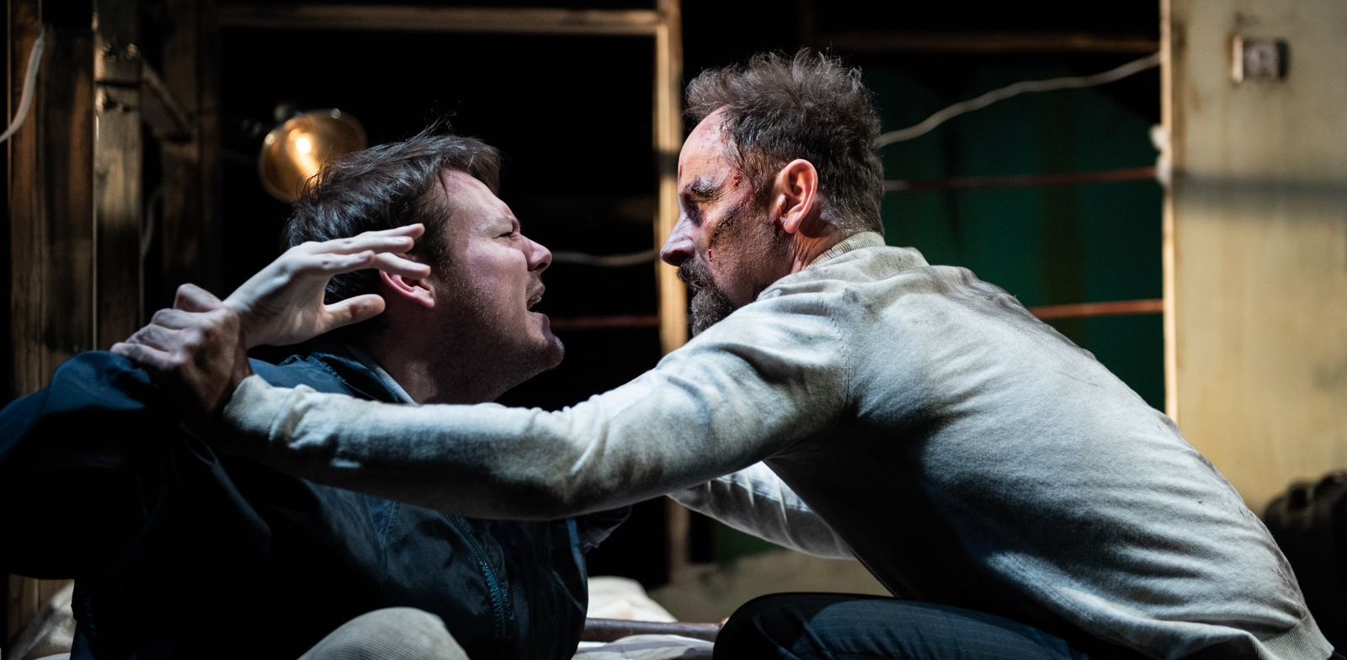
Roderick Ford’s The Spider’s House. Photo credit: Luca Truffarelli.

Slide 4
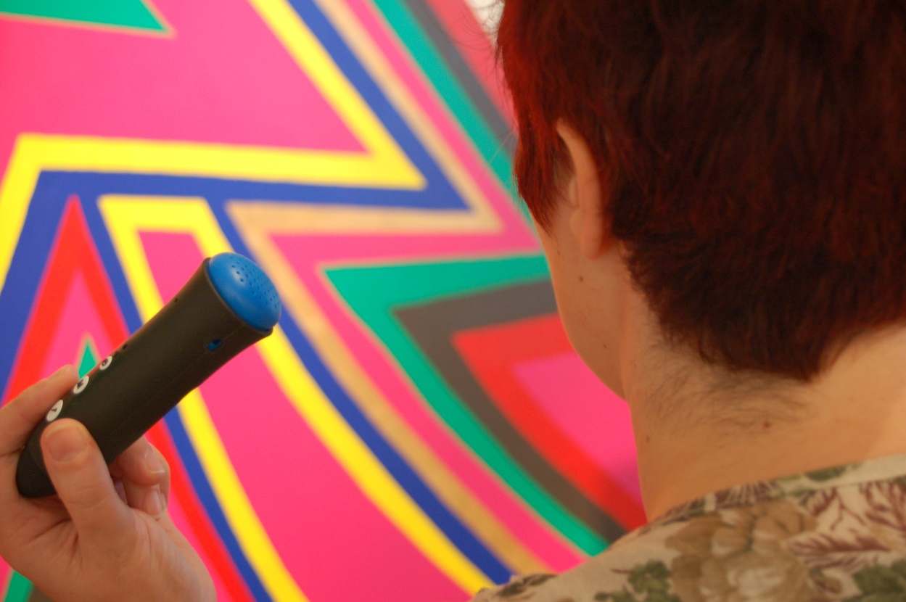
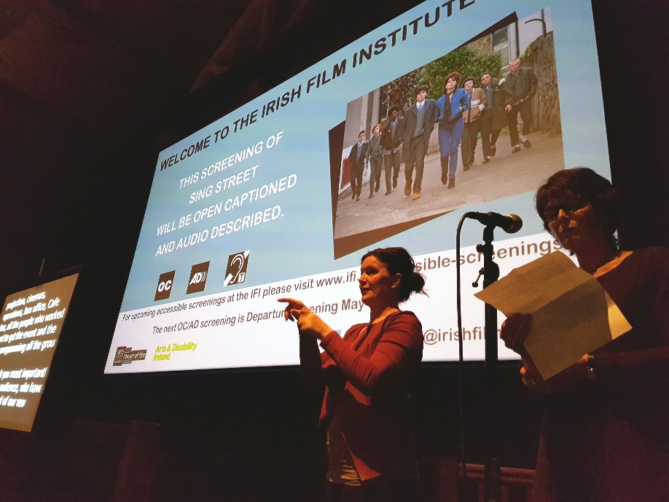
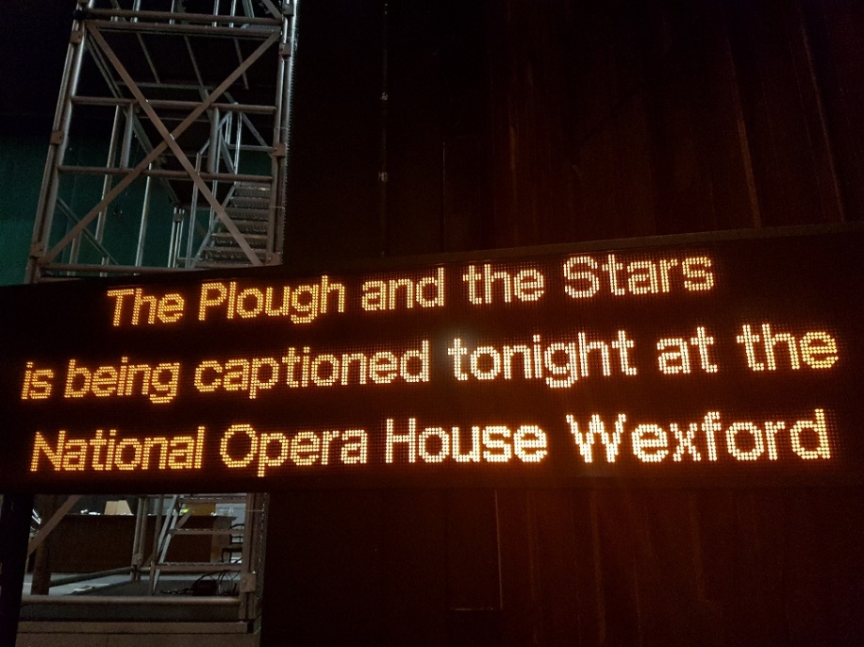

Slide 6
Summit Overview
9th – 23rd March
30 Presenters
2 Keynotes
5 Panel Discussions
3 Workshops
4 Evening Events

Slide 7
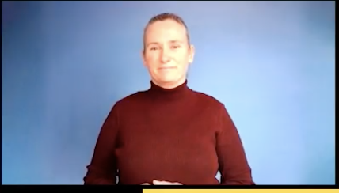
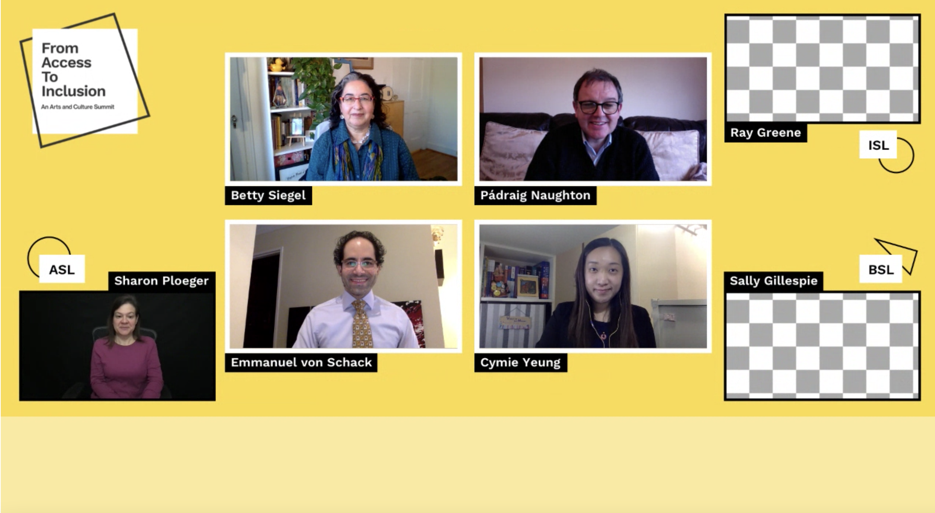
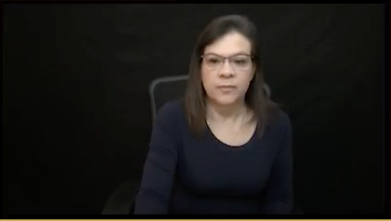
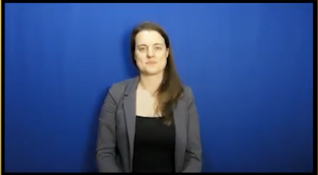
Screen Layout
Speech to Text (CART) will be visible here

Slide 8
Networking Rooms!
Breakout Room
Meet and mingle with 25 of your peers
Chat Room
Connect directly with the previous sessions presenters

Slide 9
Audience Engagement
1,036 watched across all 3 symposium sessions
21 countries: Ireland, USA, UK, Hong Kong, Netherlands, Portugal, Germany, Canada, Romania, Mexico, Belgium, Singapore Sweden + 8 others
Average time per session: 58m 27s - 2h 55m 41s

Slide 10
Funders & Sponsors

Slide 11
Follow us on Social Media!
ArtsAndDisabilityIreland
ADIarts
ArtsAndDisabilityIreland

Slide 12
Pádraig Naughton
Executive Director
padraig@adiarts.ie
www.adiarts.ie

